Slide 1



POSCO International CRM Innovation TF
User Manual_Common&Master
2025. 10

Slide 2
Contents_PC
Step 1
Menu
Menu 1.1 Menu Selection
Step 2
Notice
Notice Inquiry 1.1 Popup Notification 1.2 Dashboard View 1.3 List View

Slide 3
Contents_PC
Step 3
News
News Management 1.1 News Registration 1.2 News Modification
News Inquiry 2.1 Dashboard View 2.2 List View
Step 4
Change Owner
Record Transfer 1.1 Record Transfer

Slide 4
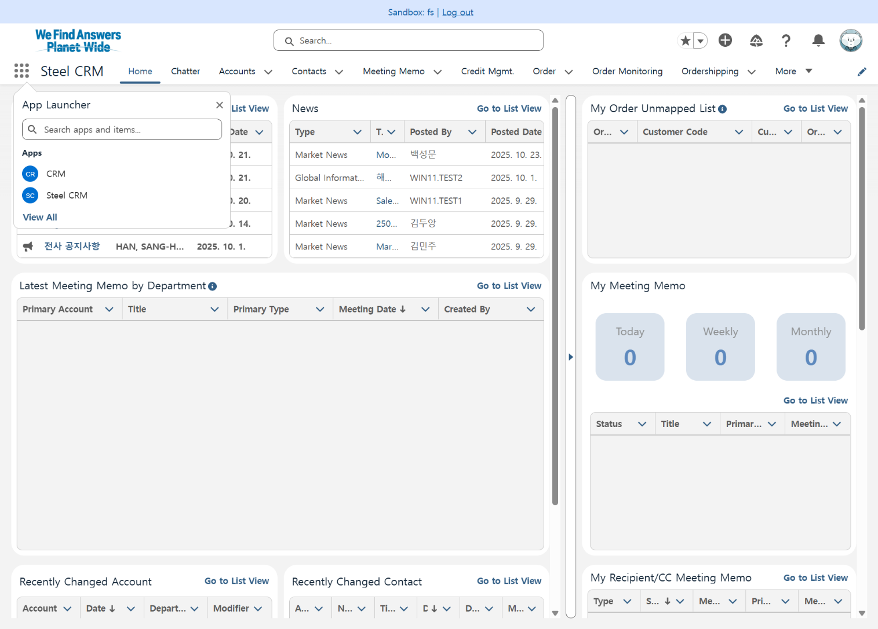
Step 1. Menu
Step (Lv.2) | 1. Menu | Step (Lv.3) | 1.1 Menu Selection
Menu | Home | User | All Users
Navigation | Home
Click [⋮⋮⋮] in the upper left corner of the Home screen
Select the required Apps from [App Launcher] Steel division users are recommended to use Steel CRM, while other users are recommended to use CRM App.
1
2

Slide 5
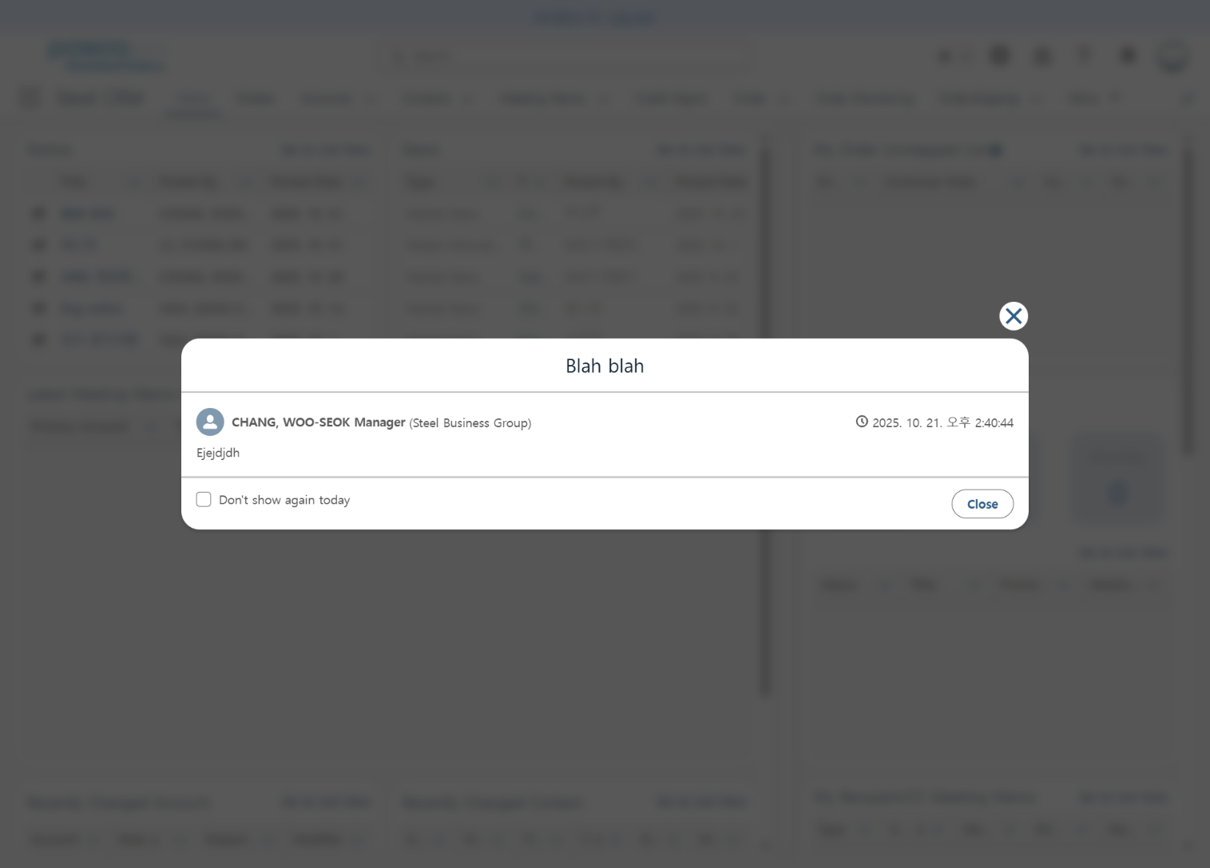
Step 2. Notice
Step (Lv.2) | 1. Notice Inquiry | Step (Lv.3) | 1.1 Notice Popup
Menu | Home | User | All Users
Navigation | Home
Click [Home] menu
[Don’t show again today] option The popup will not open for 24 hours from the time the option is selected.
Close popup
Close popup
1
4
2
3

Slide 6
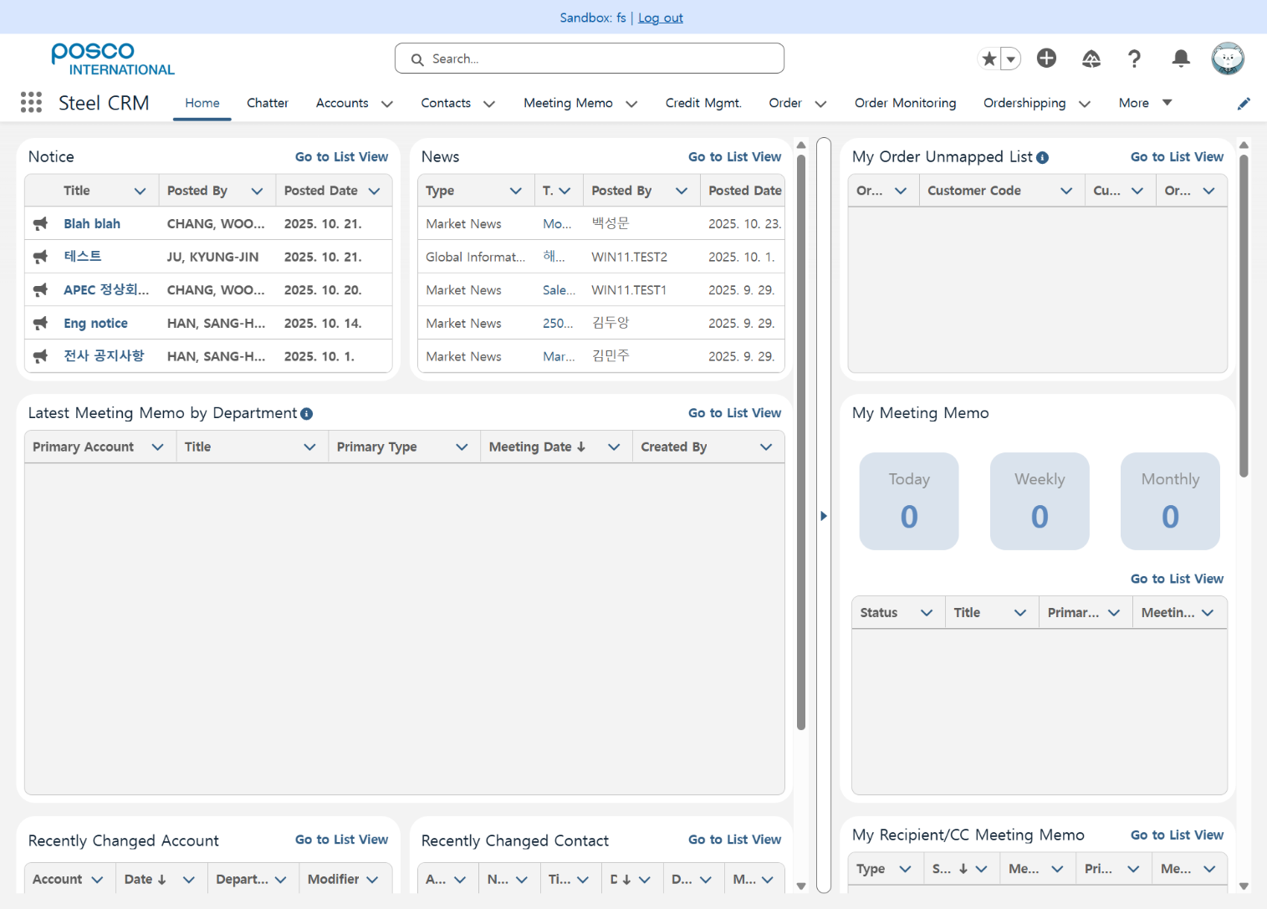
Step 2. Notice
Step (Lv.2) | 1. Notice Inquiry | Step (Lv.3) | 1.2 Dashboard View
Menu | Home | User | All Users
Navigation | Home
Click [Home] menu
Check announcements on the dashboard
1
2

Slide 7
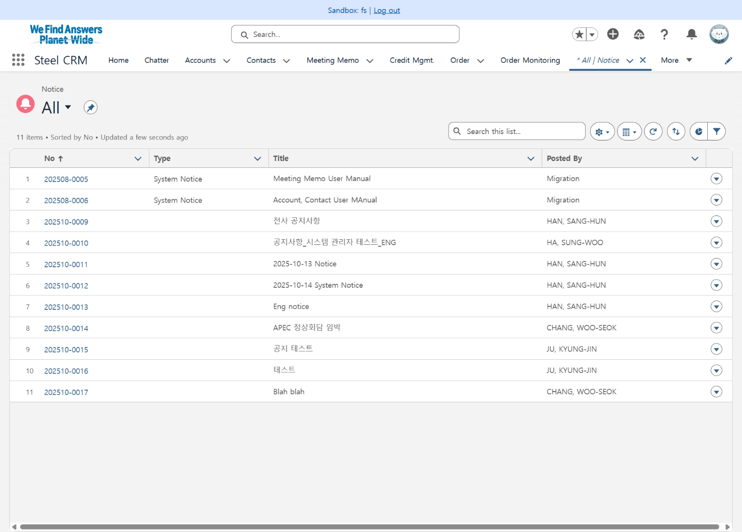
Step 2. Notice
Step (Lv.2) | 1. Notice Inquiry | Step (Lv.3) | 1.3 List View (1/2)
Menu | Notice | User | All Users
Navigation | Notice > All
Click [Notice] menu
View Notice list
Click notice number to navigate to detail page
1
2
3

Slide 8
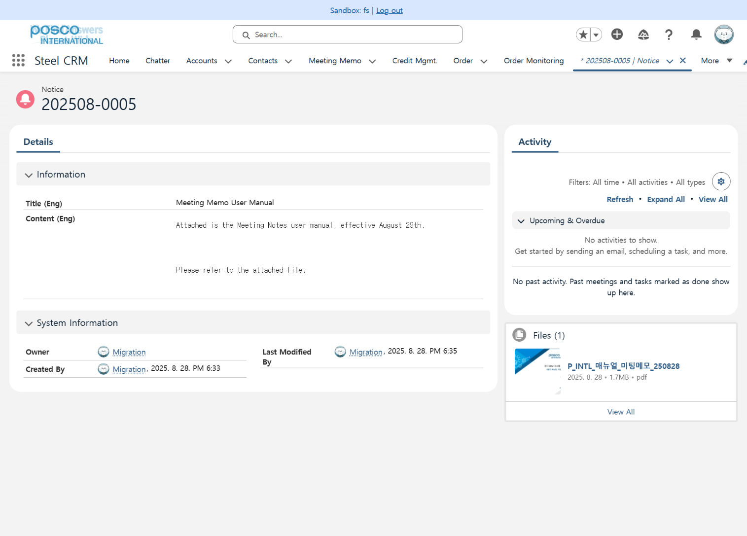
Step 2. Notice
Step (Lv.2) | 1. Notice Inquiry | Step (Lv.3) | 1.3 List View (2/2)
Menu | Notice | User | All Users
Navigation | Notice > All
Notice number
Details
1
2

Slide 9
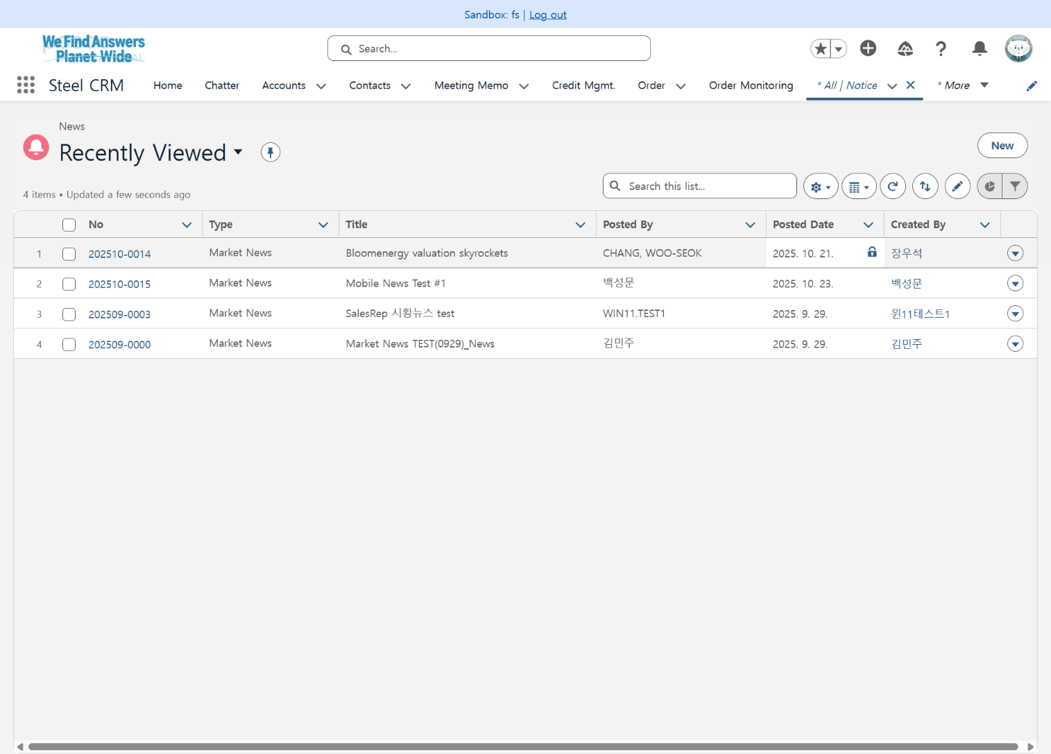
Step 3. News
Step (Lv.2) | 1. News Management | Step (Lv.3) | 1.1 News Registration (1/2)
Menu | News | User | All Users
Navigation | News > All
Click [News] menu
Click [New] button
1
2

Slide 10
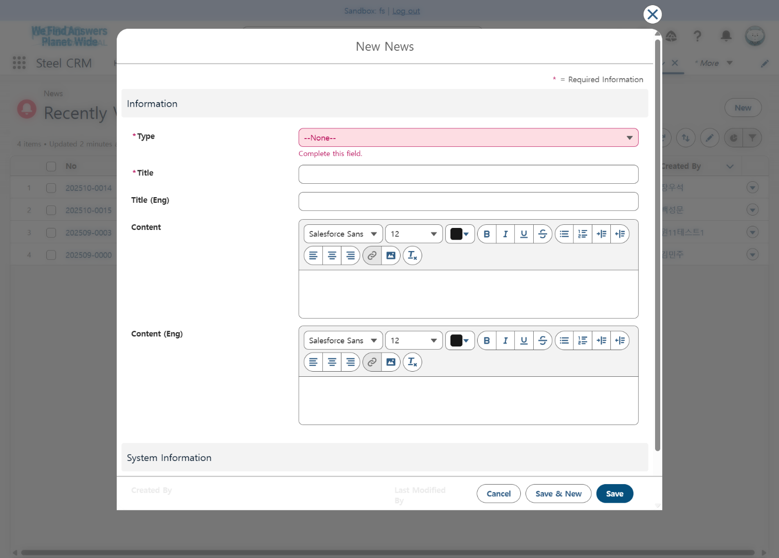
Step 3. News
Step (Lv.2) | 1. News Management | Step (Lv.3) | 1.1 News Registration (2/2)
Menu | News | User | All Users
Navigation | News > All > New News
Select Type (* Required) Category: Market News, News Clipping, Global Information
Enter Title (* Required)
Enter Title (English)
Enter Content
Enter Content (English)
Cancel, Save & New, Save
1
2
3
4
5
6

Slide 11
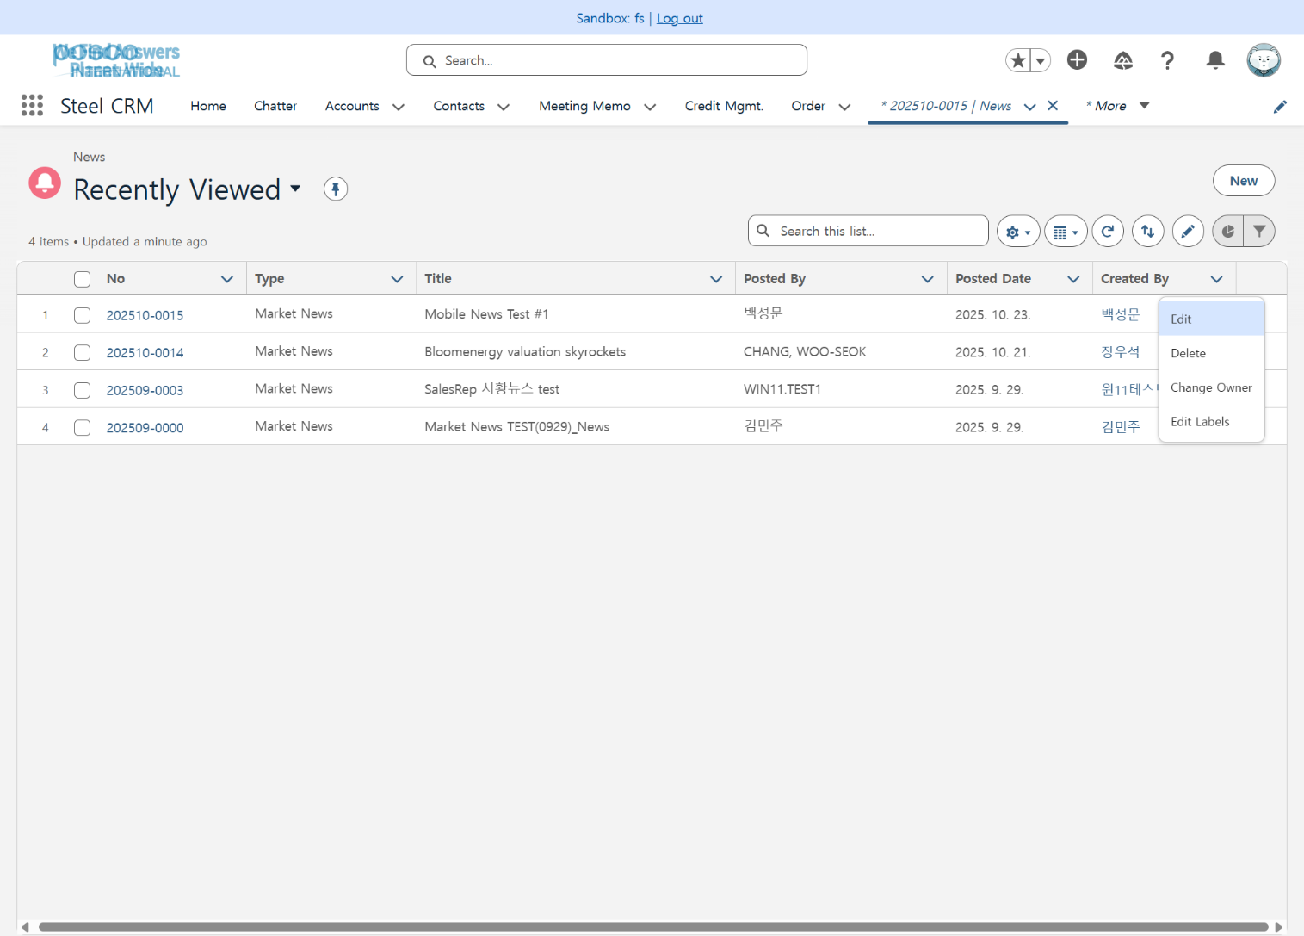
Step 3. News
Step (Lv.2) | 1. News Management | Step (Lv.3) | 1.2 News Modification (1/2)
Menu | News | User | All Users
Navigation | News > All
Click item menu in news list > [Edit] Users can only edit or delete their own news
1

Slide 12
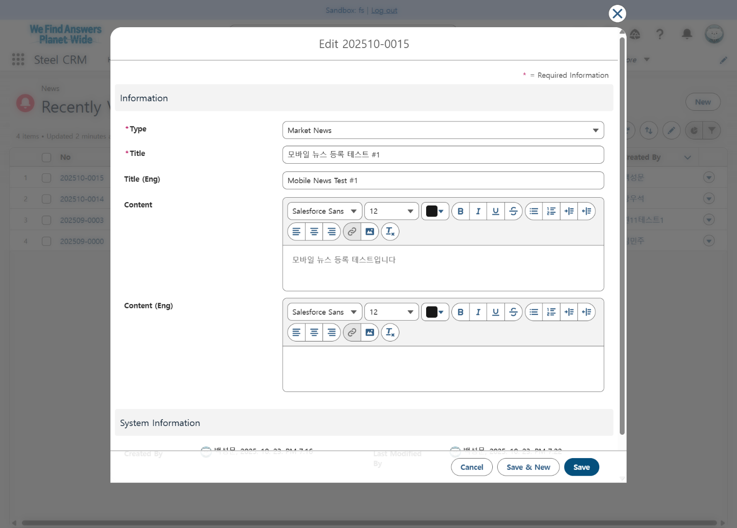
Step 3. News
Step (Lv.2) | 1. News Management | Step (Lv.3) | 1.2 News Modification (2/2)
Menu | News | User | All Users
Navigation | News > All
Select Type (* Required) Category: Market News, News Clipping, Global Information
Enter Title (* Required)
Enter Title (English)
Enter Content
Enter Content (English)
Cancel, Save & New, Save
1
2
3
4
5
6

Slide 13
Step 3. News
Step (Lv.2) | 2. News Inquiry | Step (Lv.3) | 2.1 Dashboard View
Menu | Home | User | All Users
Navigation | Home
Click [Home] menu
Check news on the dashboard Dashboard news visibility scope: Domestic employees: Within the same division Overseas employees: All scope
1
2

Slide 14
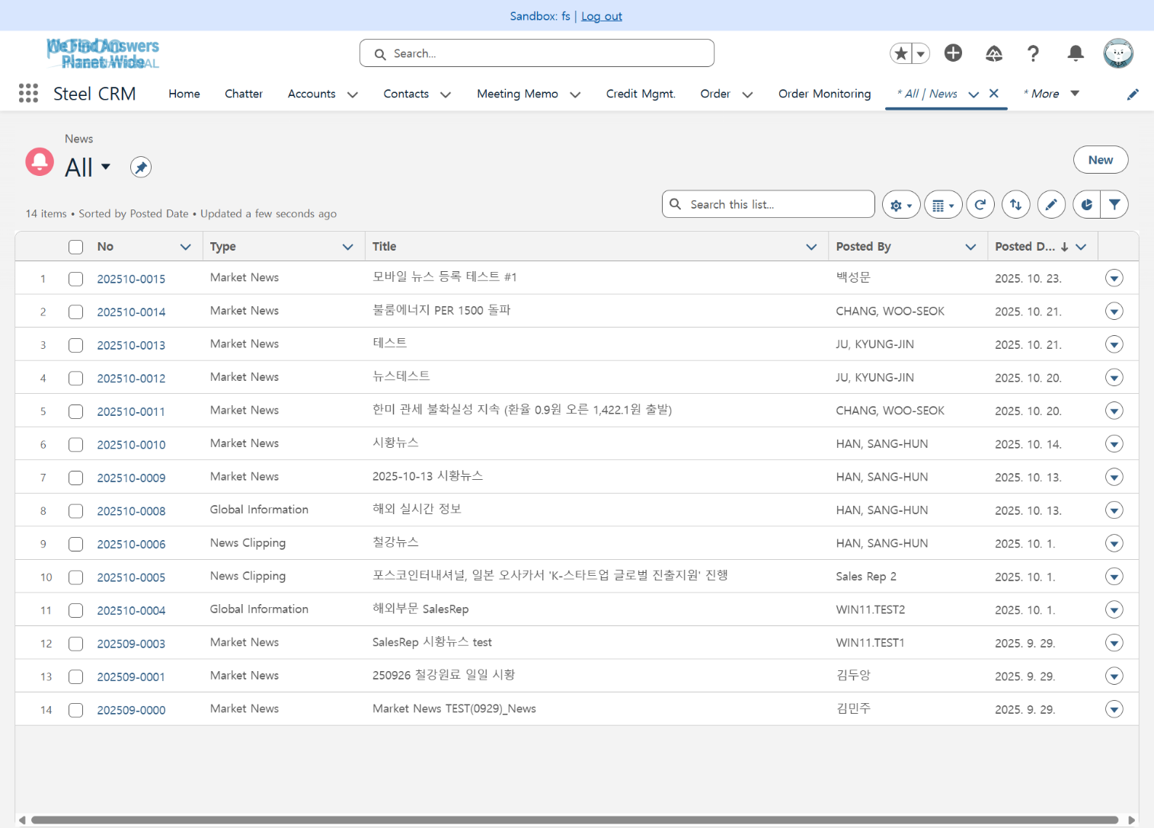
Step 3. News
Step (Lv.2) | 2. News Inquiry | Step (Lv.3) | 2.2 List View (1/2)
Menu | News | User | All Users
Navigation | News > All
Click [News] menu
View news list List news visibility scope: Domestic employees: All scope Overseas employees: All scope
Click news number to navigate to detail page
1
2
3

Slide 15
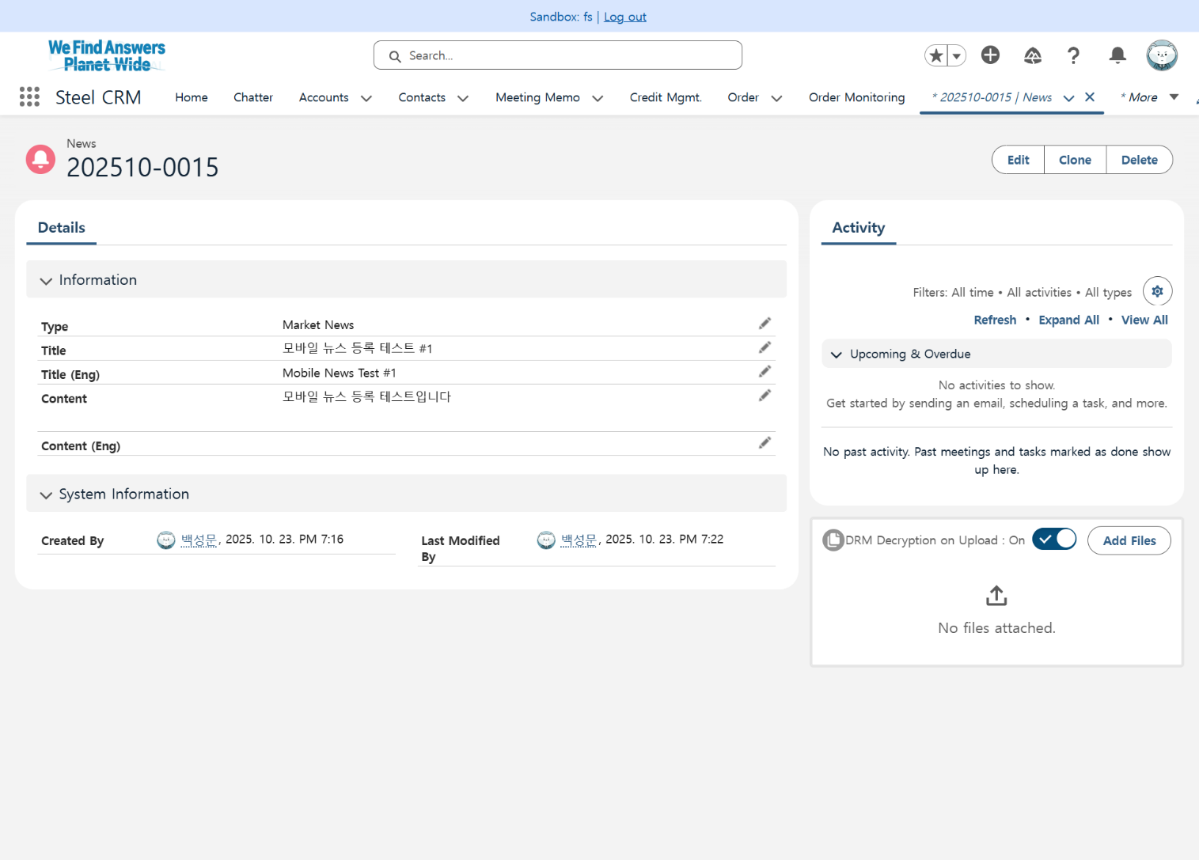
Step 3. News
Step (Lv.2) | 2. News Inquiry | Step (Lv.3) | 2.2 List View (2/2)
Menu | News | User | All Users
Navigation | News > All
News number
Details
1
2

Slide 16
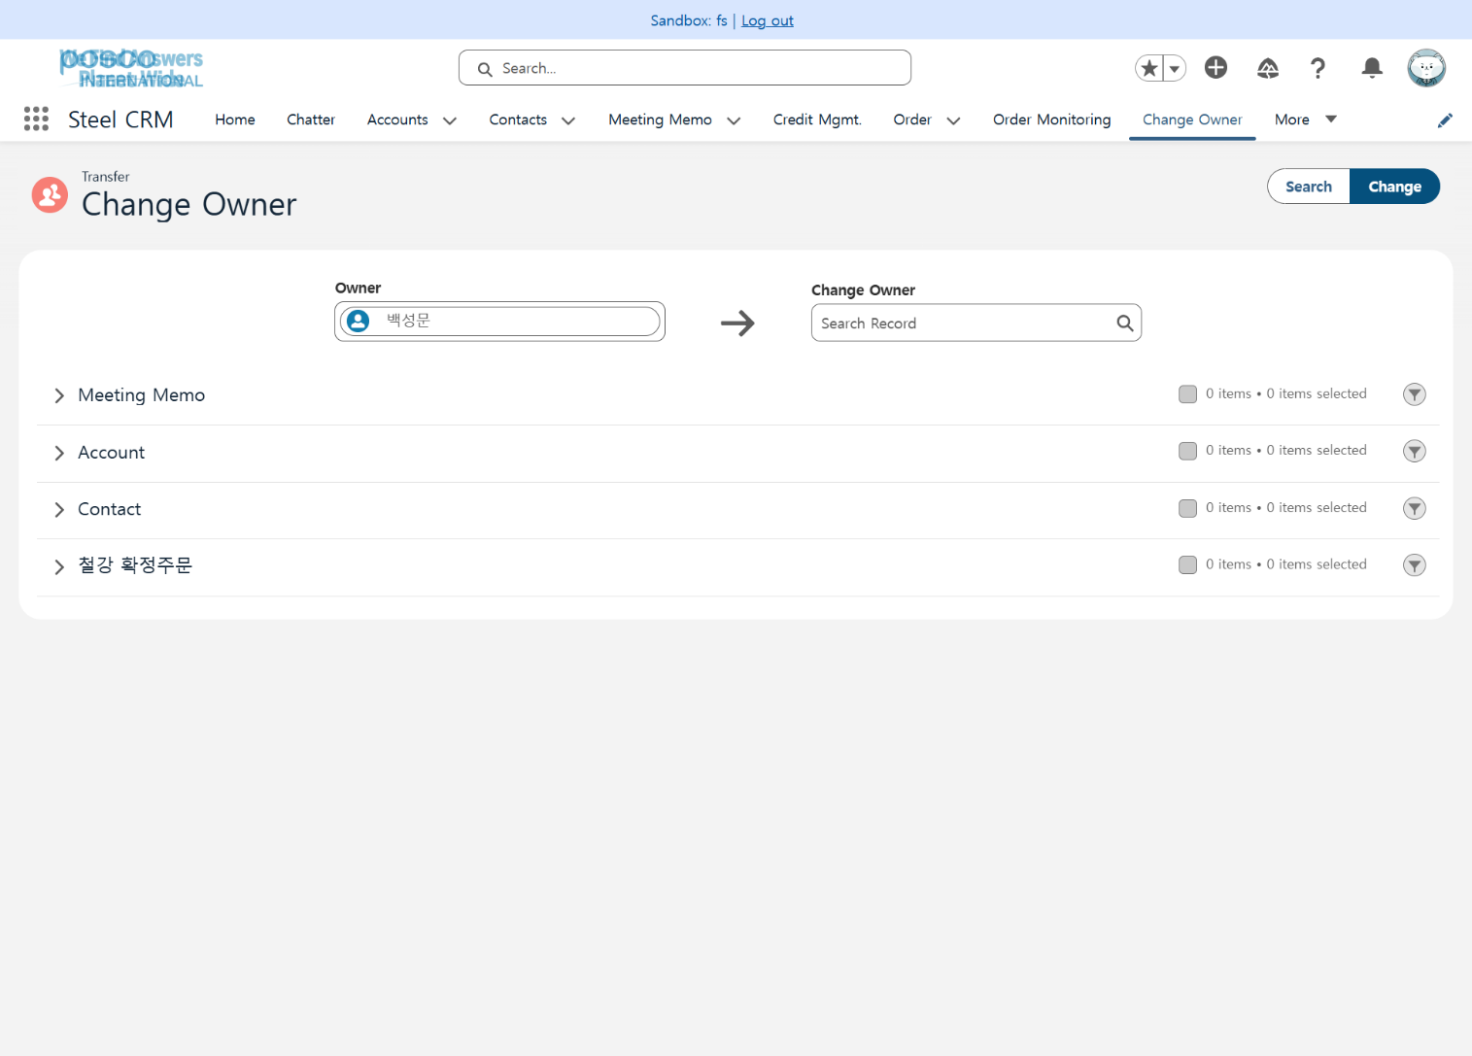
Step 4. Change Owner
Step (Lv.2) | 1. Record Transfer | Step (Lv.3) | 1.1 Record Transfer
Menu | Change Owner | User | All Users
Navigation | Change Owner > Transfer
Click [Change Owner] menu
Set Owner / Change Owner Owner: User who will transfer records (Default: Currently logged-in user) Change Owner: User who will receive records (Search users after clicking text box)
Click [Search] button after setting Change Owner to retrieve transferable records
Select records to transfer in each category
Click [Change] button to transfer selected records
1
3
5
2
4

Slide 17
Contents_Mobile
Step 1
Login
App Login 1.1 App Login
Step 2
Menu
Menu 1.1 Menu Selection

Slide 18
Contents_Mobile
Step 3
Notice
Notice Inquiry 1.1 List View
Step 4
News
News Inquiry 1.1 List View
News Management 2.1 News Registration 2.2 News Modification

Slide 19
Contents_Mobile
Step 5
Change Owner
Record Transfer 1.1 Record Transfer

Slide 20
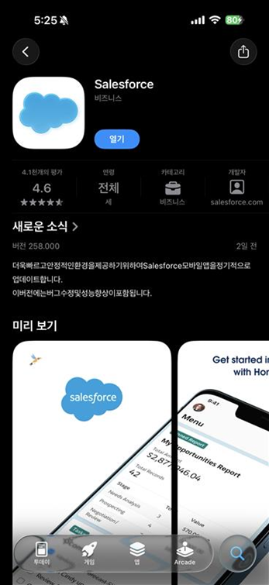
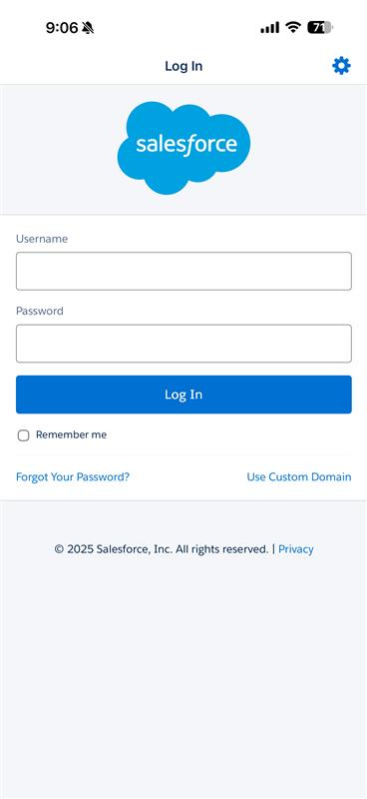
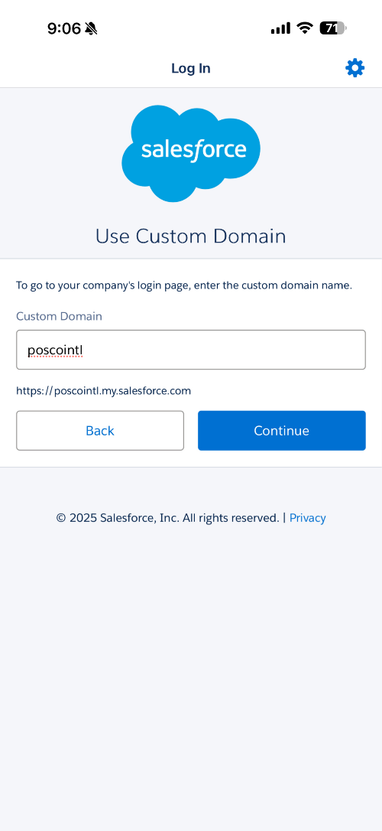
Step 1. Login
Step (Lv.2) | 1. App Login | Step (Lv.3) | 1.1 App Login(1/3)
Menu |  | User | All Users
Navigation
Download 'Salesforce' from Apple App Store/Google Play Store and run Apple App Store: https://apps.apple.com/kr/app/salesforce/id404249815 Google Play Store: https://play.google.com/store/apps/details?id=com.salesforce.chatter&pcampaignid=web_share
Click [Use Custom Domain] button
Enter 'poscointl' in the custom domain input field
Verify that the domain at the bottom changes to https://poscointl.my.salesforce.com
Click [Continue] button
1
3
4
5
2

Slide 21
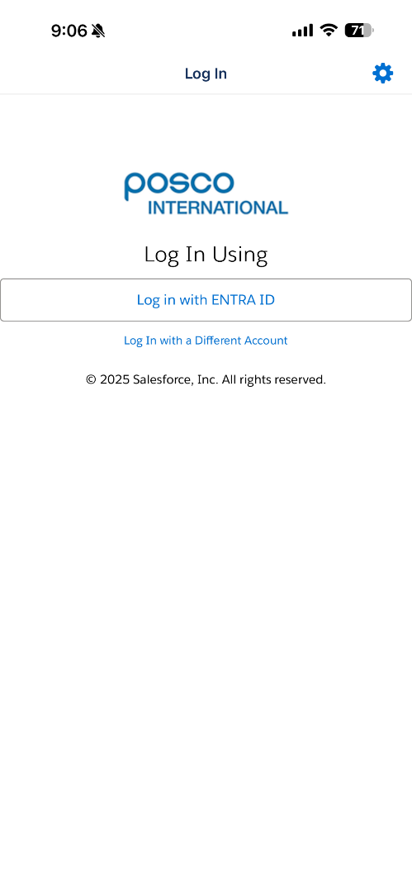
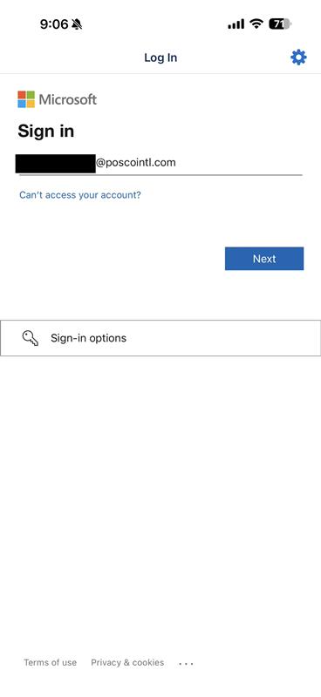
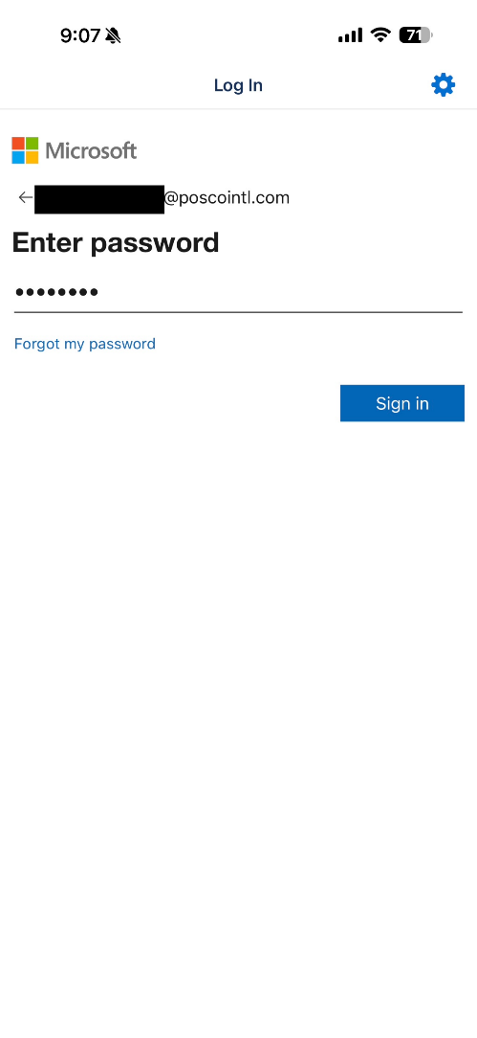
Step 1. Login
Step (Lv.2) | 1. App Login | Step (Lv.3) | 1.1 App Login(2/3)
Menu |  | User | All Users
Navigation
Click [Login with ENTRA ID] button
Enter Entra ID e.g. EP ID@poscointl.com
Click [Next] button
Enter Entra PW e.g. EP PW
Click [Sign in] button
2
4
1
3
5

Slide 22
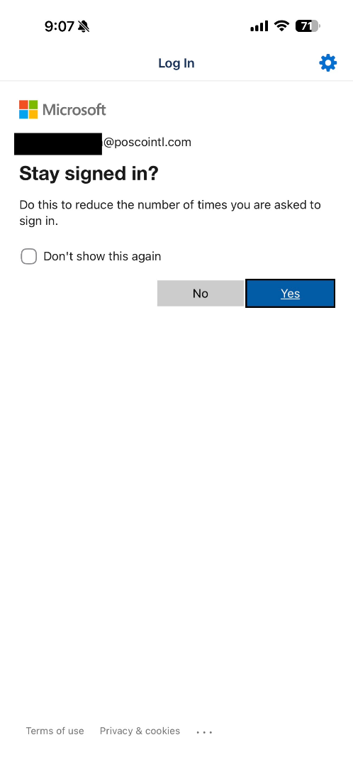
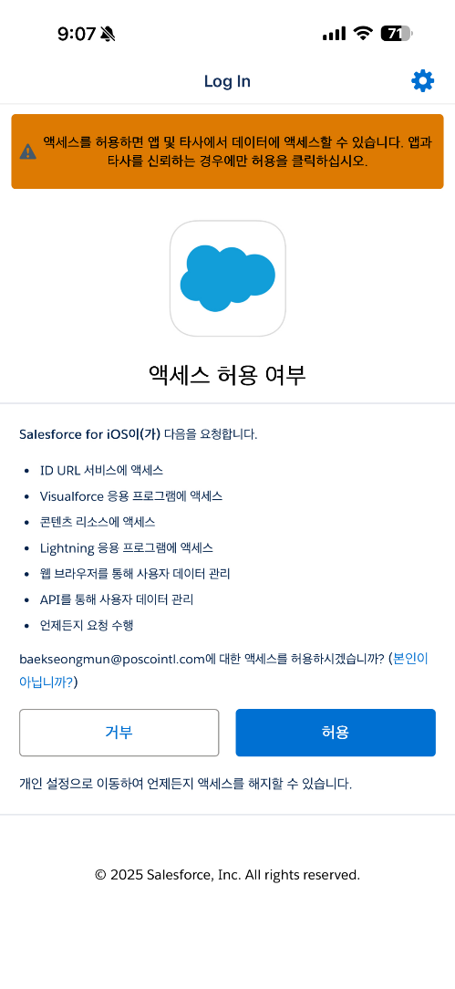
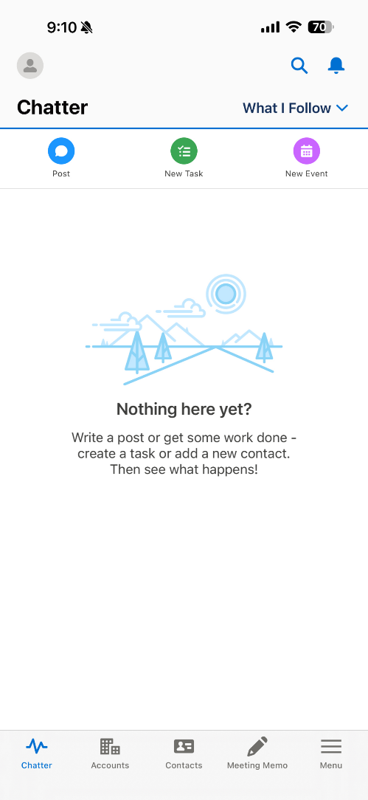
Step 1. Login
Step (Lv.2) | 1. App Login | Step (Lv.3) | 1.1 App Login(3/3)
Menu |  | User | All Users
Navigation
When 'Don't show again' option is selected, this screen will not appear again in the current session
Clicking [Yes] button maintains the session even after closing the browser
Click [Allow] button to allow Salesforce for iOS access If [Deny] is selected, Salesforce for iOS application cannot be used.
Login completed
1
2
3

Slide 23

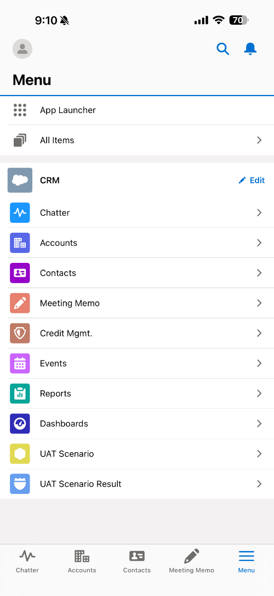
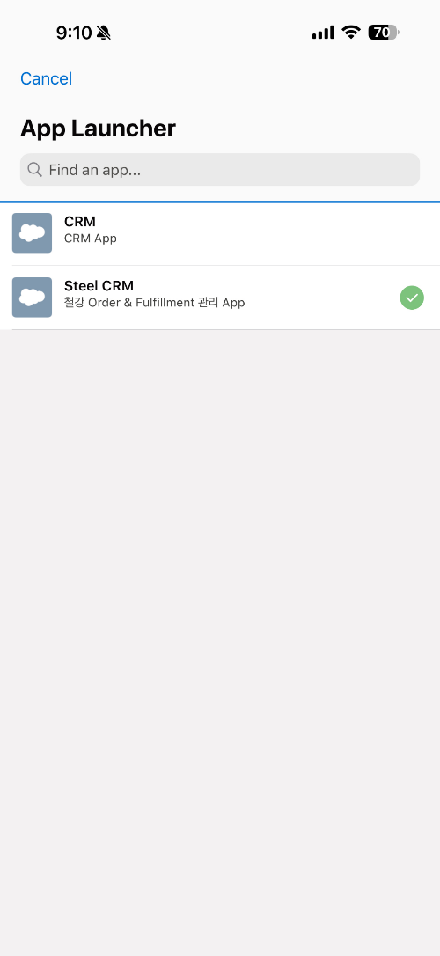
Step 2. Menu
Step (Lv.2) | Menu | Step (Lv.3) | 1.1 Menu Selection
Menu | Menu | User | All Users
Navigation | Menu > App Launcher
Click [Menu] button in the bottom navigation bar to navigate to menu screen
Select [App Launcher] to access App Launcher
Select required Apps from [App Launcher] Steel division users are recommended to use Steel CRM, while other users are recommended to use CRM App.
2
3
1
1

Slide 24
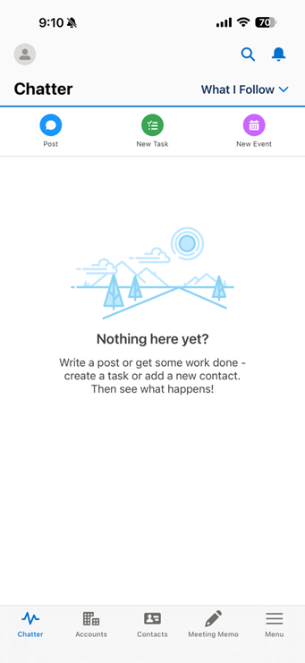
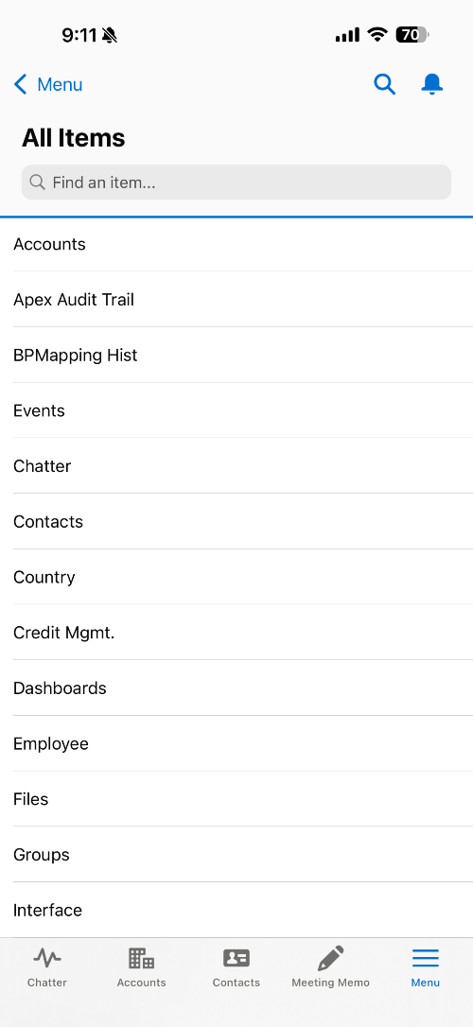
Step 3. Notice
Step (Lv.2) | 1. Notice Inquiry | Step (Lv.3) | 1.1 List View(1/3)
Menu | Notice | User | All Users
Navigation | Notice
Click [Menu] button in the bottom navigation bar to navigate to menu screen
Select [All Items] to access all menus
2
1
1

Slide 25
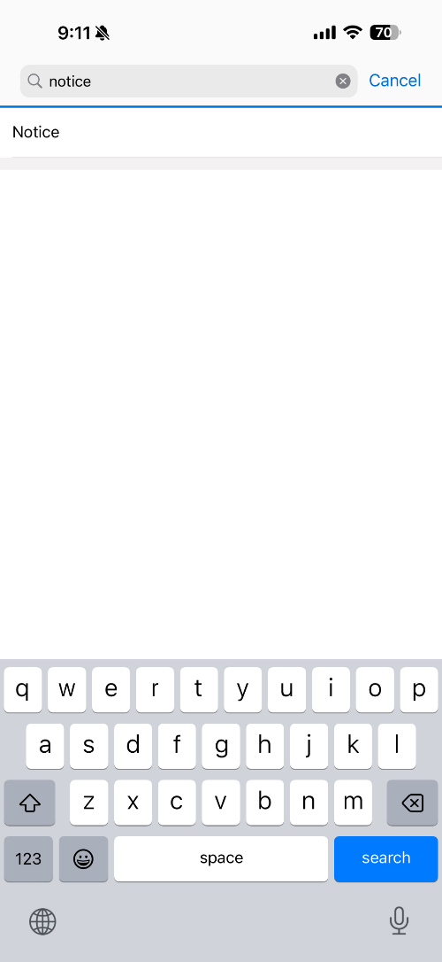
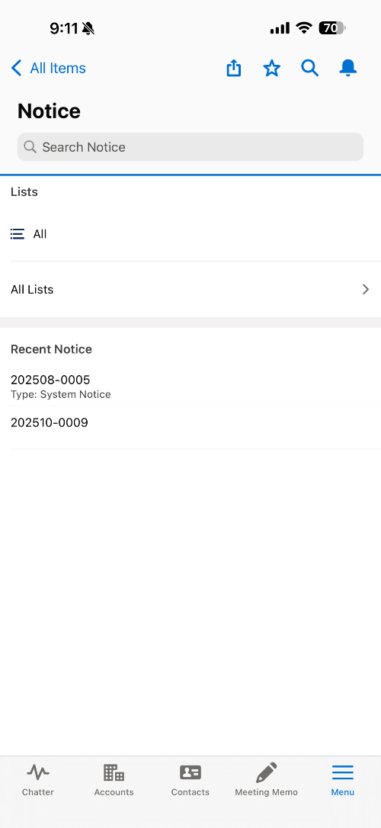
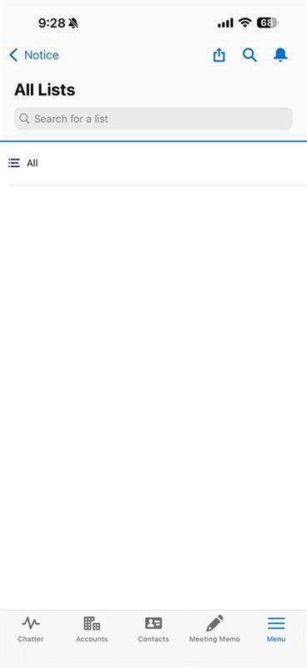
Step 3. Notice
Step (Lv.2) | 1. Notice Inquiry | Step (Lv.3) | 1.1 List View(2/3)
Menu | Notice | User | All Users
Navigation | Notice
Search 'Announcement' in the search bar
Select [Announcement] to navigate to announcement menu
Click [All Lists]
Click [All]
1
2
4
3
1

Slide 26
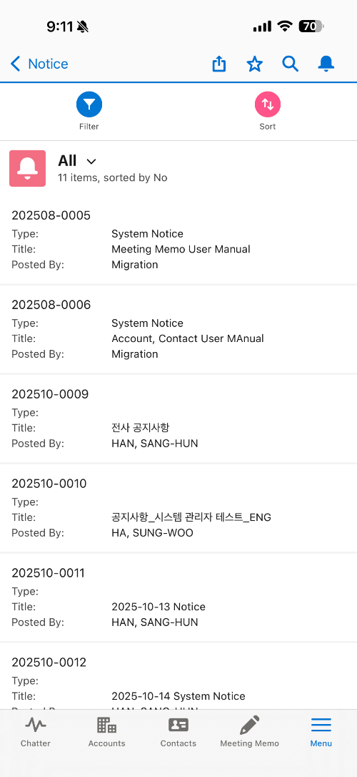
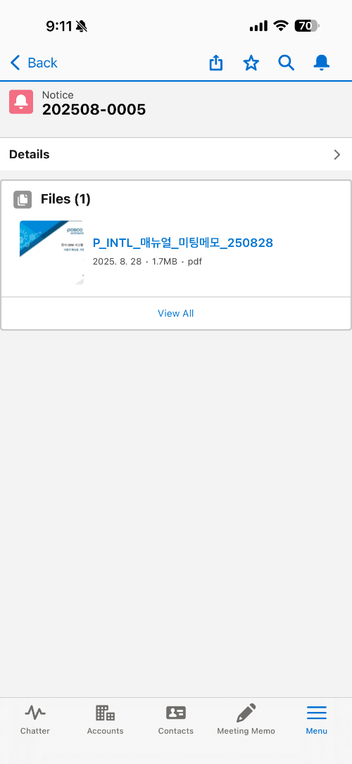
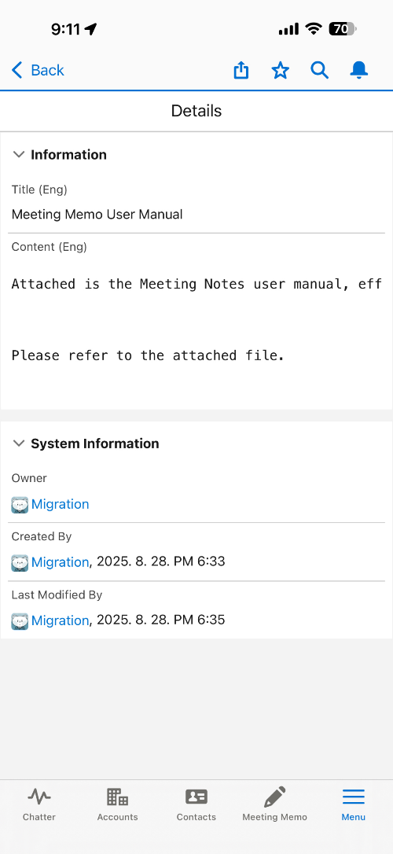
Step 3. Notice
Step (Lv.2) | 1. Notice Inquiry | Step (Lv.3) | 1.1 List View(3/3)
Menu | Notice | User | All Users
Navigation | Notice
Select item from announcement list
Click [Details] button
View announcement details
2
1
3
1

Slide 27

Step 4. News
Step (Lv.2) | 1. News Inquiry | Step (Lv.3) | 1.1 List View(1/3)
Menu | News | User | All Users
Navigation | News
Click [Menu] button in the bottom navigation bar to navigate to menu screen
Select [All Items] to access all menus
2
1
1

Slide 28
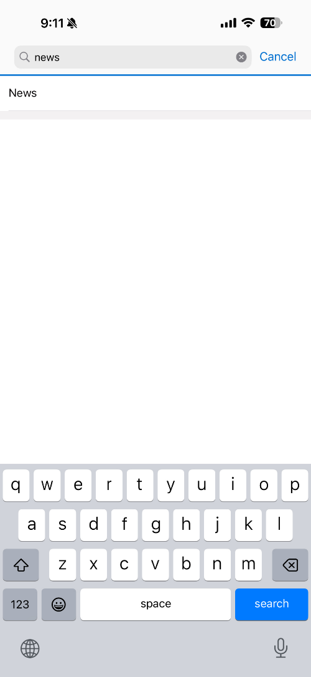
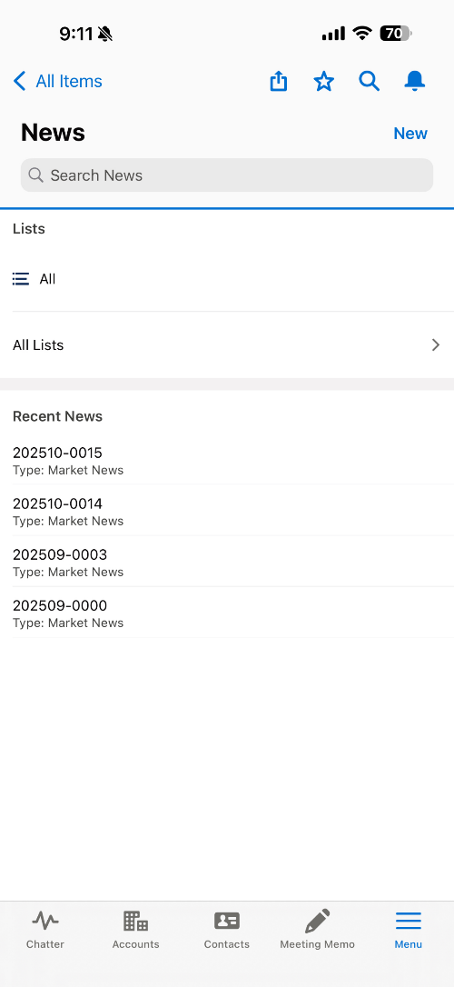
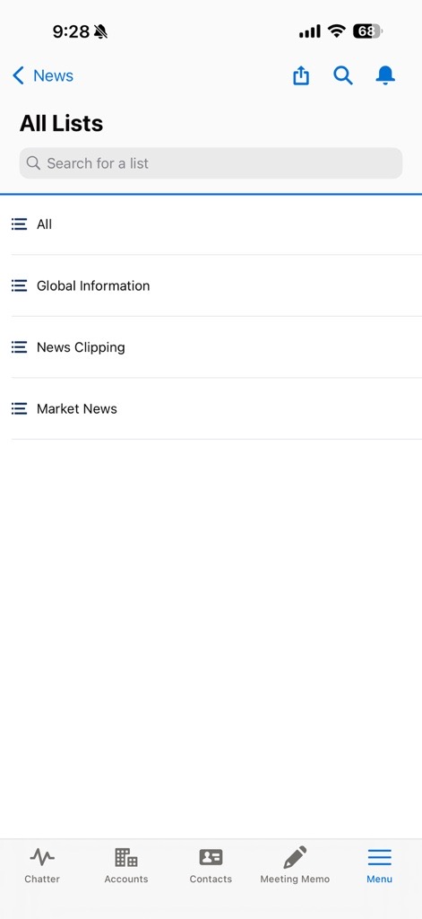
Step 4. News
Step (Lv.2) | 1. News Inquiry | Step (Lv.3) | 1.1 List View(2/3)
Menu | News | User | All Users
Navigation | News
Search 'News' in the search bar
Select [News] to navigate to news menu
Click [All Lists]
Click [All]
1
2
4
3
1

Slide 29
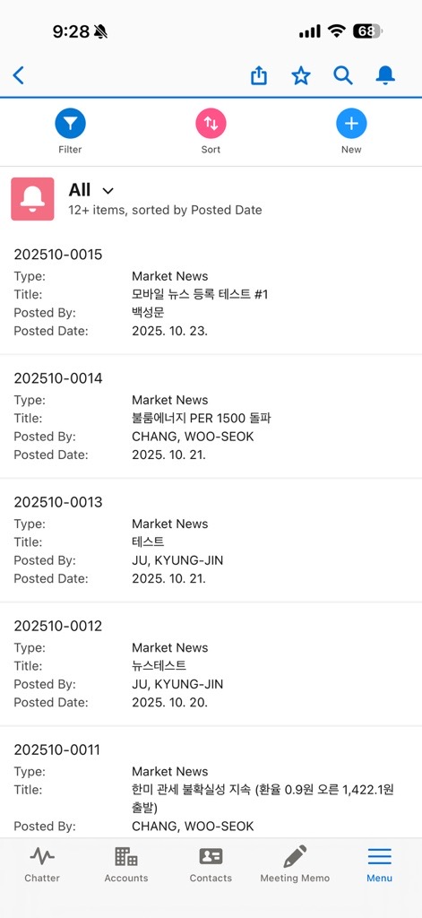
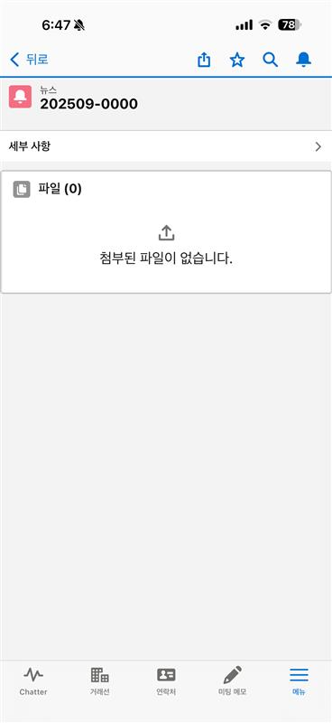
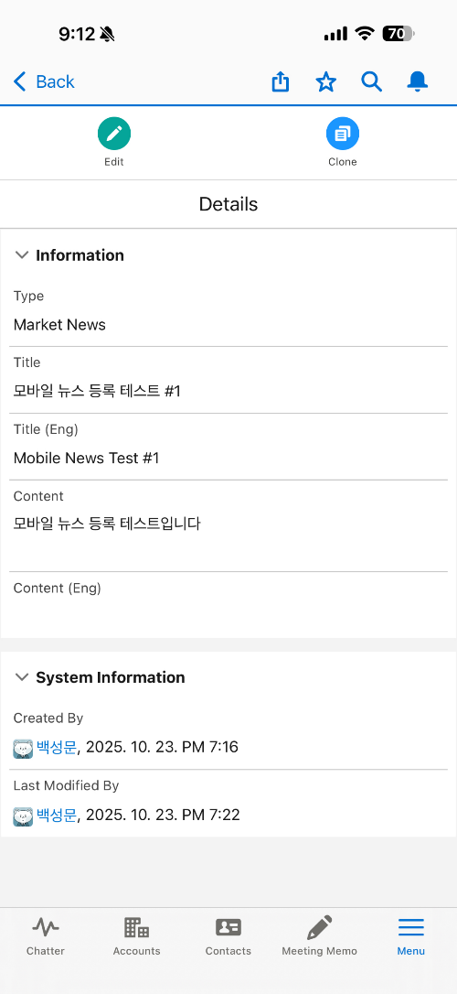
Step 4. News
Step (Lv.2) | 1. News Inquiry | Step (Lv.3) | 1.1 List View(3/3)
Menu | News | User | All Users
Navigation | News
Select item from news list
Click [Details] button
View news details
2
1
3
1

Slide 30
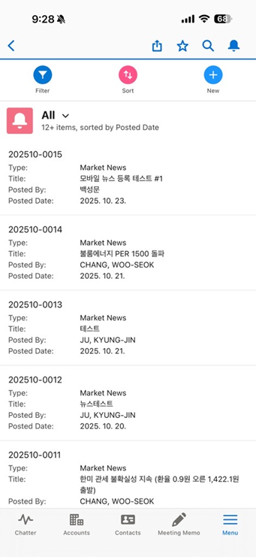
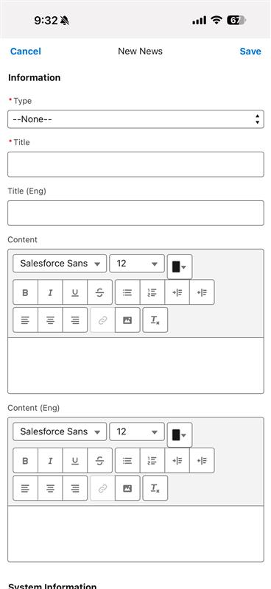
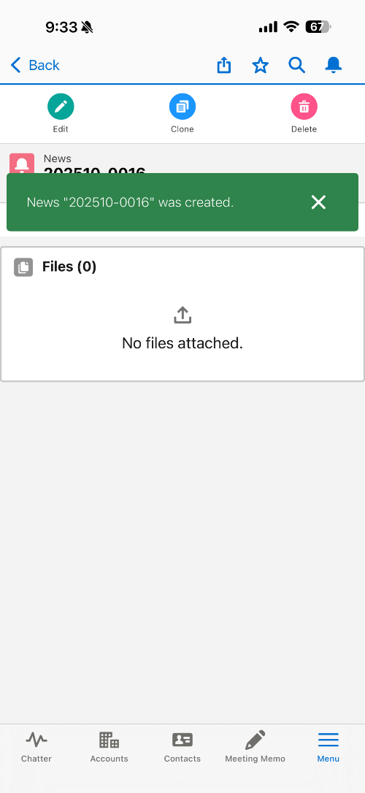
Step 4. News
Step (Lv.2) | 2. News Management | Step (Lv.3) | 2.1 News Registration
Menu | News | User | All Users
Navigation | News
Click [New] button from news list
Enter Category, Title, Content Category: Market News, News Clipping, Global Information
Click [Save] button
News registration completed
1
2
4
1

Slide 31
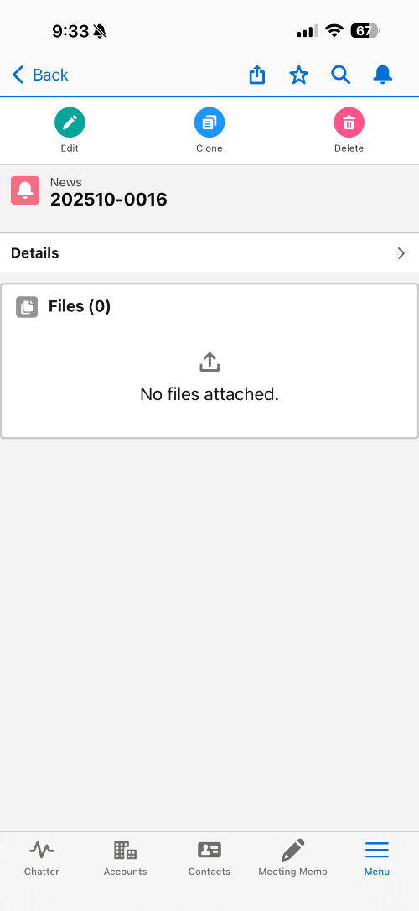
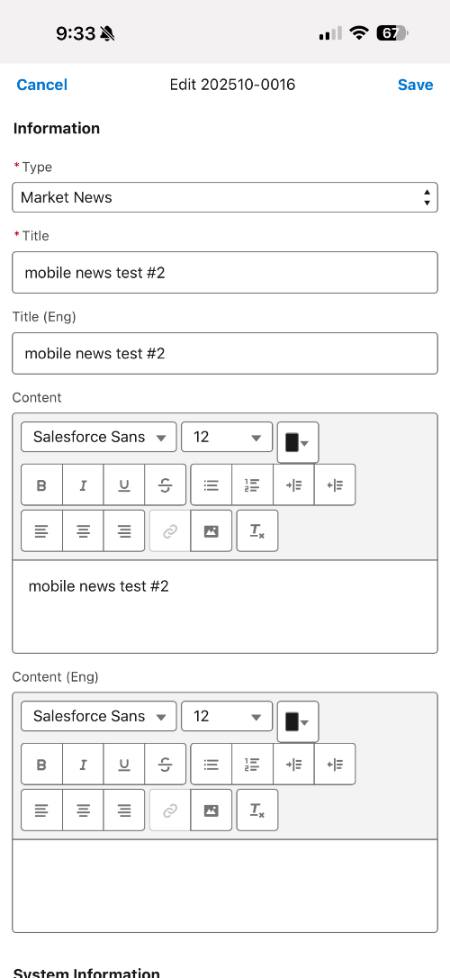
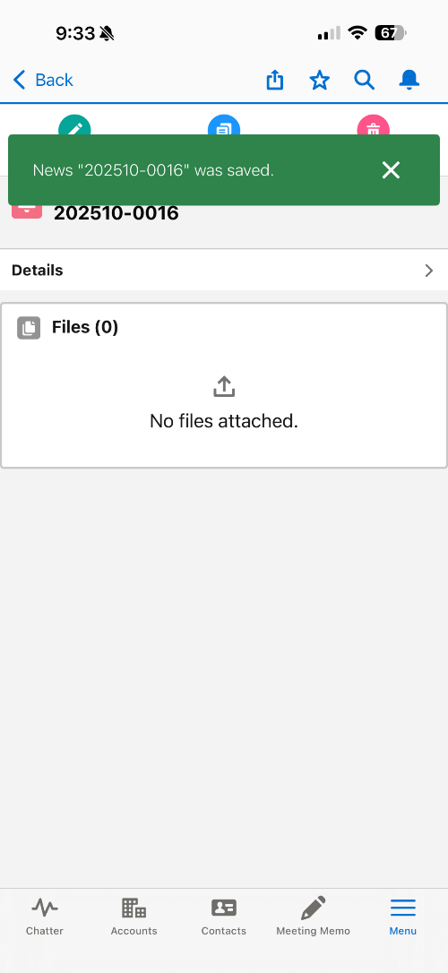
Step 4. News
Step (Lv.2) | 2. News Management | Step (Lv.3) | 2.2 News Modification
Menu | News | User | All Users
Navigation | News
Select your news from news list and click [Edit] button Users can only edit or delete their own news
Enter Category, Title, Content Category: Market News, News Clipping, Global Information
Click [Save] button
News modification completed
4
2
1

Slide 32
Step 5. Change Owner
Step (Lv.2) | 1. Record Transfer | Step (Lv.3) | 1.1 Record Transfer(1/2)
Menu | Change Owner | User | All Users
Navigation | Change Owner
Click [Menu] button in the bottom navigation bar to navigate to menu screen
Select [All Items] to access all menus
2
1
1

Slide 33
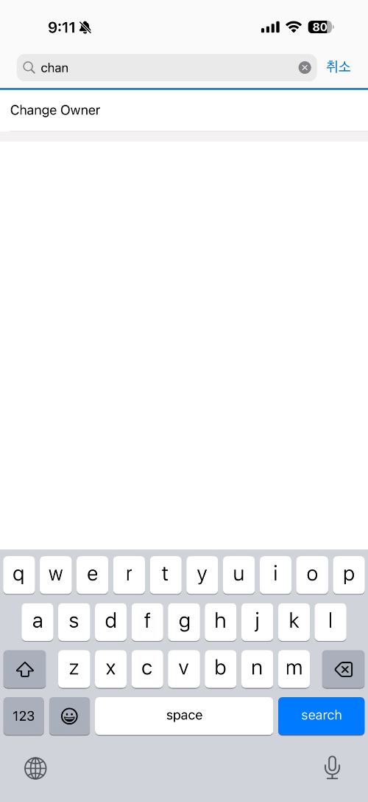
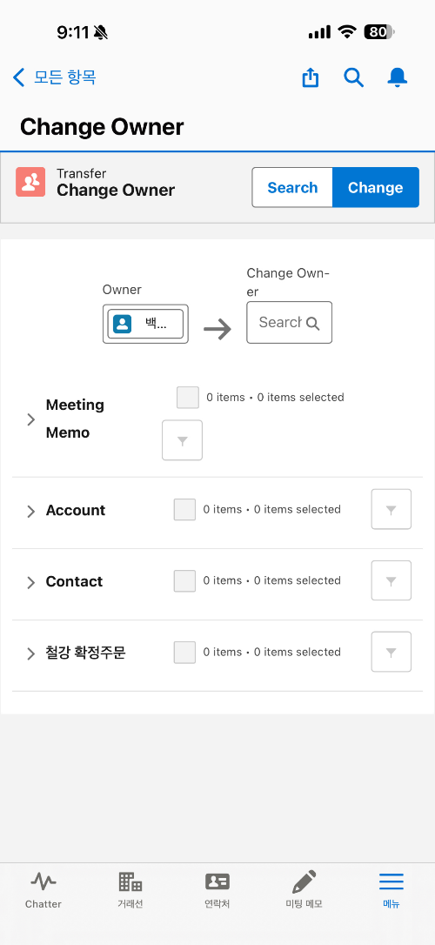
Step 5. Change Owner
Step (Lv.2) | 1. Record Transfer | Step (Lv.3) | 1.1 Record Transfer(2/2)
Menu | Change Owner | User | All Users
Navigation | Change Owner
Search 'Change Owner' in the search bar
Select [Change Owner] to navigate to Change Owner menu
Set Owner / Change Owner Owner: User who will transfer records (Default: Currently logged-in user) Change Owner: User who will receive records (Search users after clicking text box)
Click [Search] button after setting Change Owner to retrieve transferable records
Select records to transfer in each category
Click [Change] button to transfer selected records
2
4
6
3
5
1

